Slide 1
Project #6 - Slurm 2
Asmita, Rocco, Samuele
The AQTIVATE project receives funding from the European Union’s HORIZON MSCA Doctoral Networks programme, under Grant Agreement No. 101072344.

Slide 2
Parallelization strategy
Two different ideas:
Simulate with 1 scalar value (angle), use CPU parallelization
Simulate with 2d Vectors and use maybe GPU parallelization
We choose idea#1 as our main strategy
The code is already scalar -> minimizes time allocated to code writing
Our parallelization strategy is twofold:
Vectorize the computation of |M| -> SIMD
Run different MC simulations in parallel -> MPI
Architecture:
Run idea#1 on DARDEL/TCBLab CPUs
If time permits, run idea#2 on DARDEL/TCBLab GPUs

Slide 3
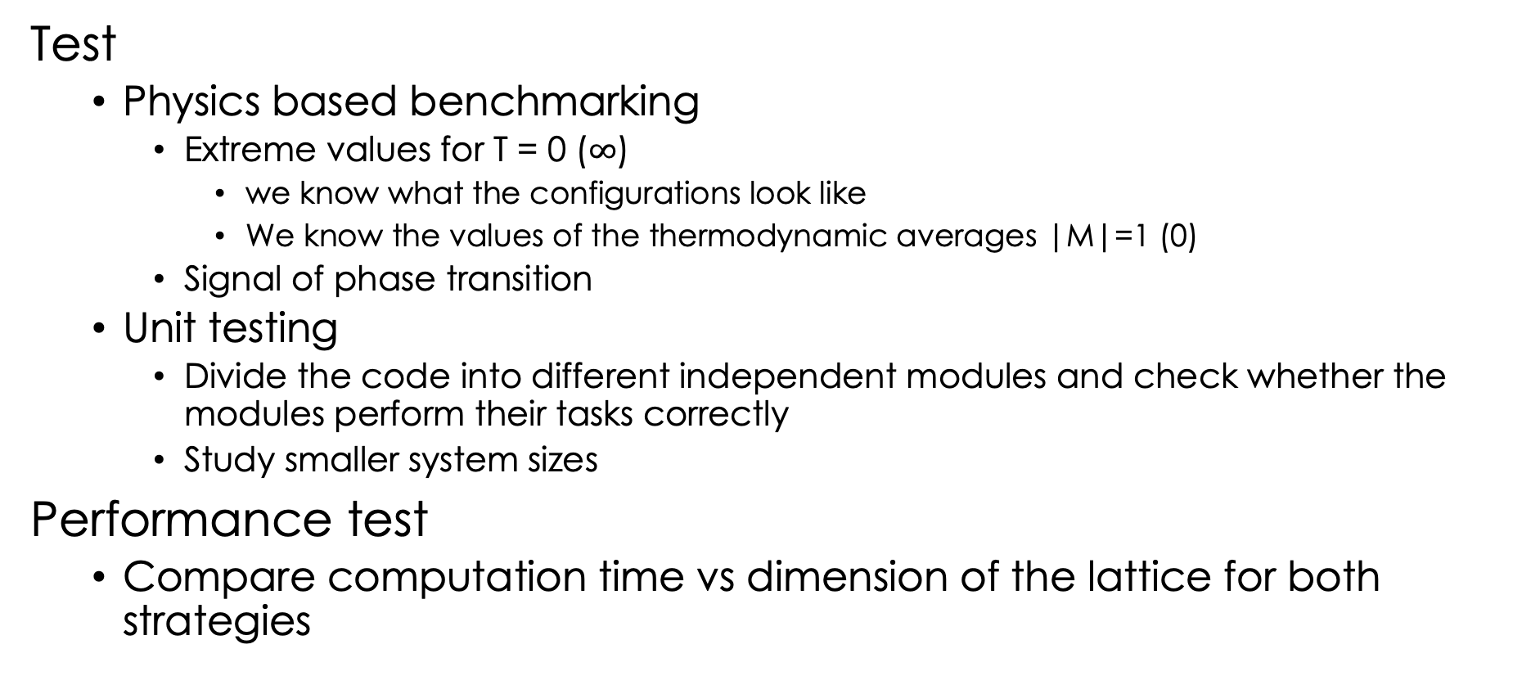
Testing strategy
Test
Physics based benchmarking
Extreme values for T = 0 ($∞$)
we know what the configurations look like
We know the values of the thermodynamic averages |M|=1 (0)
Signal of phase transition
Unit testing
Divide the code into different independent modules and check whether the modules perform their tasks correctly
Study smaller system sizes
Performance test
Compare computation time vs dimension of the lattice for both strategies

